Slide 1

Practical 6
Scanning and Mapping Internal Network & Host Devices
Ethnical Hacking
Diploma in CSF Year 3 (2020/21), Semester 5
Notes:
Left-hand Bar – Replace FSP by your module code and X by the lecture number.
Replace Lecture Title
Replace < Module Name >
Replace Year and Semester if necessary

Slide 2
Introduction
In a typical Black Hat pen-testing exercise, the pen-testers need to search for vulnerable host devices after penetrated the perimeter devices. Thereafter they will be able to map out the complete network diagrams in the organization.
In cases where the client would like to know if the host devices found are vulnerable to attack, the pen-testers will carry out vulnerability scanning on each of the targeted machines.
In this practical, we will walk you through the complete process of finding the host devices in Hacking-Lab. and scan selected devices for vulnerabilities. Hacking-Lab is a service by Security Competence GmbH, a Swiss subsidiary of Compass Security AG.
If not Covid19, you would do this practical using our WoCAT setup. However, you can use most of the skills later when you return to the school.

Slide 3
Learning Objectives
At the end of this practical, the students would be able to
find out the subnets in the target organization, scan for live hosts in each of the subnets and to map out a network diagram for the target organization.

Slide 4
Contents
Tasks
Task 1 - Learning about Hacking-Lab Network Architecture
Task 2 - Getting an User Account at Hacking-Lab
Task 3 - Start Hacking-Lab Live CD VM and VPN into Hacking-Lab
Task 4 - Network Sweeping for Live Hosts
Task 5 - Scan Devices for Open Ports
Challenge

Slide 5

Important Instructions
You will do this lab at home.
You will need a Hacking-lab VM already configured for your use. You can obtain it from your class's Team or download from source and make the VM yourself. https://livecd.hacking-lab.com/largefiles/livecd/daily/
The network setting of the VM will be set to BRIDGED. Unless you have a USB network adapter, if not, please use network cable to connect directly to the LAN port of your home’s Wireless Router.

Slide 6
Task 1 - Learning about Hacking-Lab Network Architecture

Slide 7
Learning about the Purpose of Hacking-Lab
Hacking-Lab is an online ethical hacking computer network and security challenge platform. It is used to train pen-testers and it is also serve as a platform for finding and educating cybersecurity talents.
Hacking-Labs’ goal is to raise awareness towards increased education and ethics in information security through a series of cyber competitions that encompass forensics, cryptography, reverse-engineering, ethical hacking and defence.
source: https://www.hacking-lab.com/about/

Slide 8
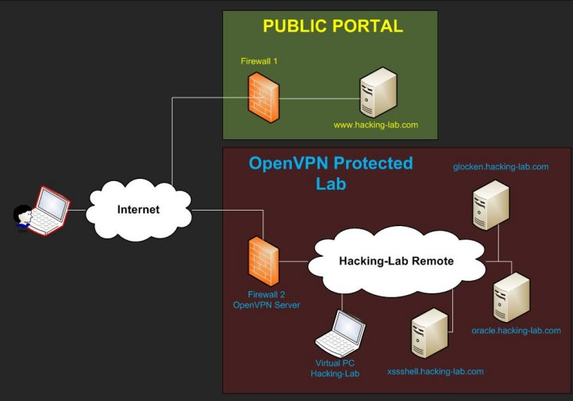
Understand the Network Architecture
To understand what are about to do in this Practical, let's look at the Hacking-Lab Network Architecture Diagram.
It has a Public Portal which provide general info and allow user to register an account. It has a lab of machines like the WoCAT system that support its pen-testing challenges.

Slide 9
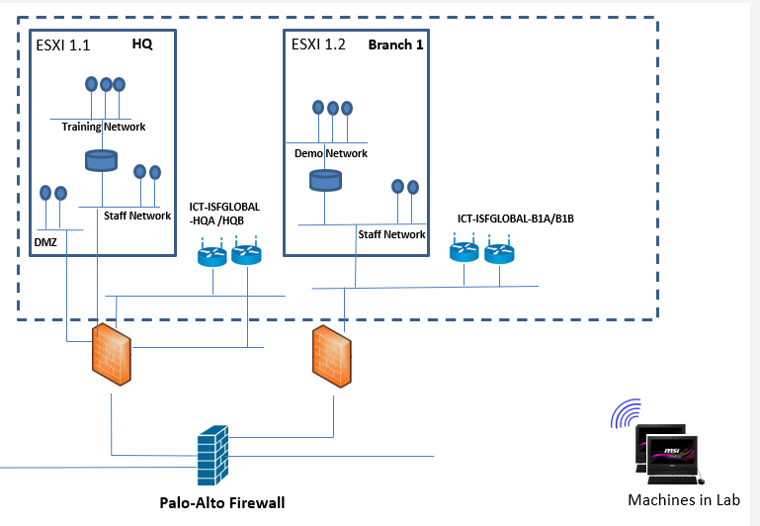
WoCAT System in School

Slide 10
Task 2 - Getting an User Account at Hacking-Lab

Slide 11
Read about Terms of Use
Please spend a bit of time to scan though the Terms of Use at the URL below:
https://www.hacking-lab.com/about/agb.html
Please be nice when you go on-line to hack at the site. There are rules to follow.
You can also sign-up as a paid member (if you want) and enjoy hacking the challenges, read the information at the URL below:
https://www.hacking-lab.com/membership/
For the purpose of this practical, you do not need to sign up as a member unless you yourself wanted to and you need to pay out of your own funds (e.g. Scholarship funds).
...

Slide 12
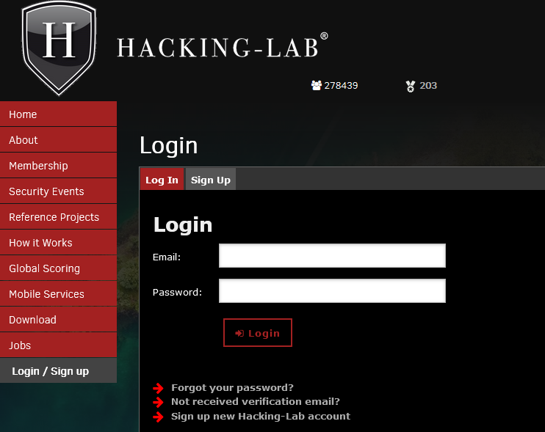
To sign up with Hacking-Lab. Point to the following URL.
https://www.hacking-lab.com/user/login/

Slide 13
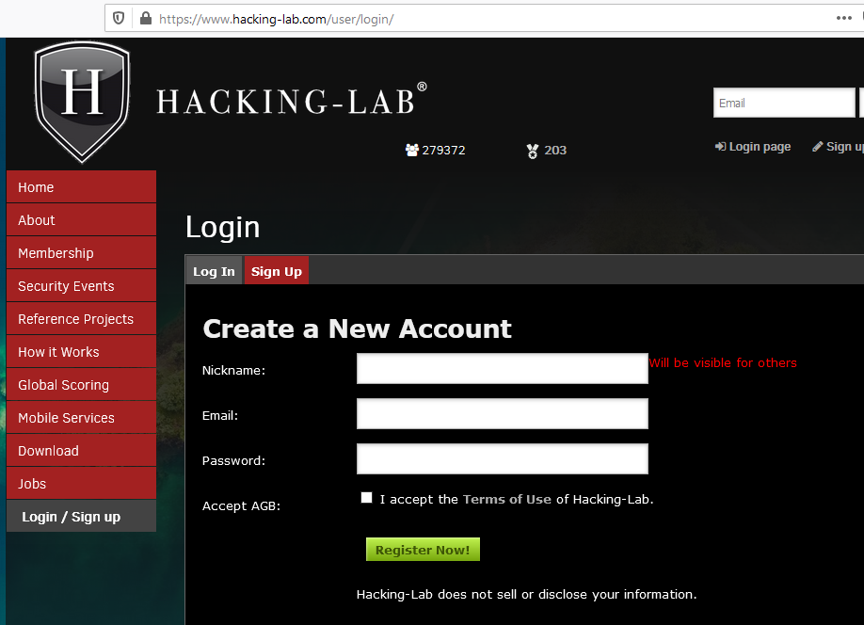

Slide 14
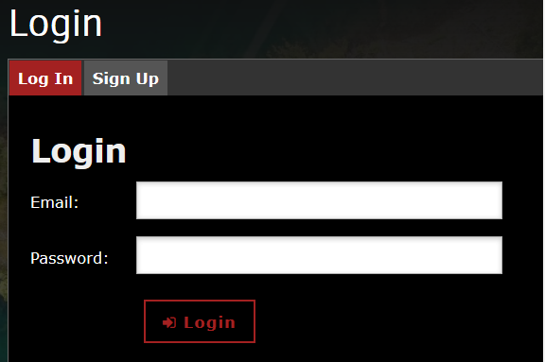
After you registered, an email with the password will be sent to you to activate your account. Use your email and password to login to the site.

Slide 15
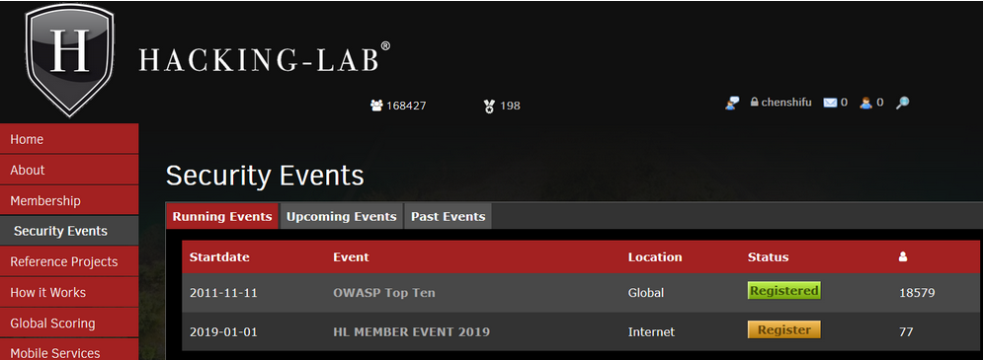
After login, the following screen will appear.
You may explore the site on your own and to try the challenges. You will now exist the site to continue.

Slide 16
Task 3 - Start Hacking-Lab Live CD VM and VPN into Hacking-Lab

Slide 17
Download Hacking-Lab VM from MS Team
Visit your Class Materials in 0421-EH-ALL channel, go to the Practical Folder in Week 6 Folder. Download the pre-prepared VM into your download folder in your PC.
Unzip the download zip file using 7zip and move the VM to where all your VMs are located.

Slide 18
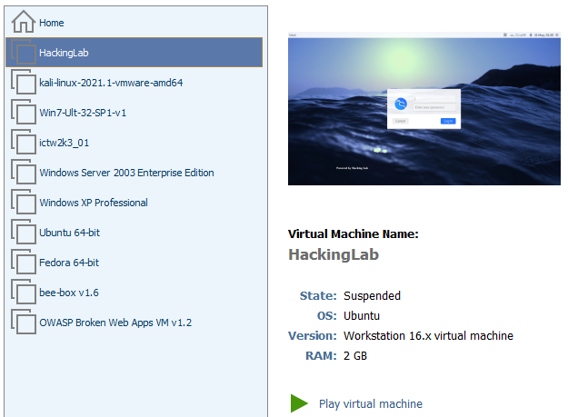
Start your VM player and point to Hacking-Lab. Click to play the virtual machine.

Slide 19
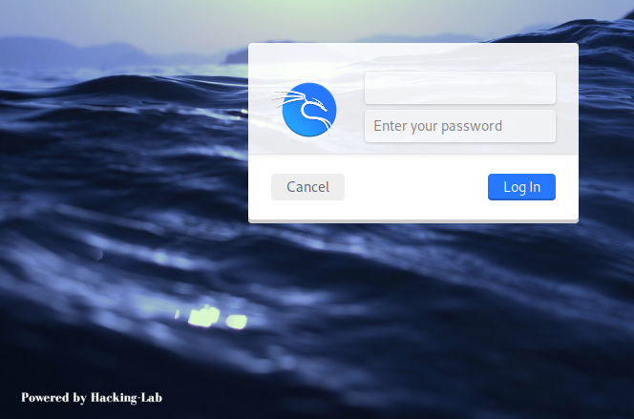
Open Hacking-Lab VM
If you have played the game to find the login ID and password as a hacker, after searching around on the Internet, you would have either found or guess it. it is hacker:compass. Use this credential to login.

Slide 20
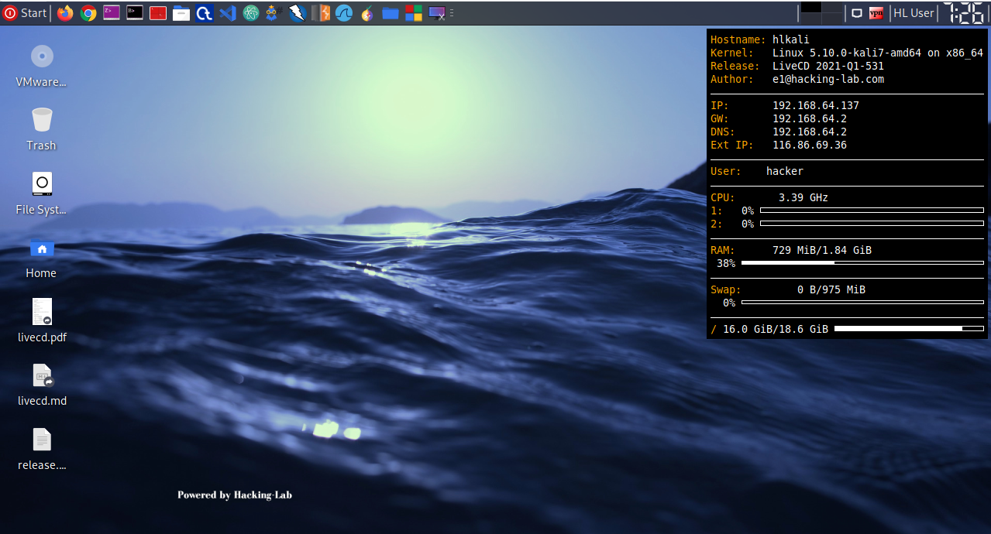
Landing page after login …

Slide 21
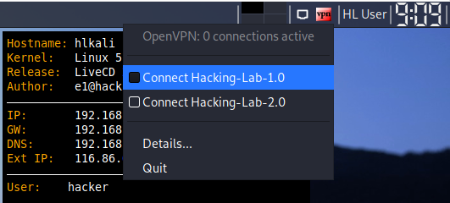
RIGHT Click on [vpn] on the top right corner to connect to the vpn server at hacking-lab.com ... Click on Connect Hacking-Lab 1.0.

Slide 22
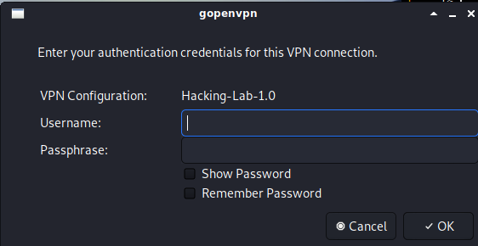
Enter the Username/email account and Password that you have entered when registered an account with www.hacking-lab.com.

Slide 23
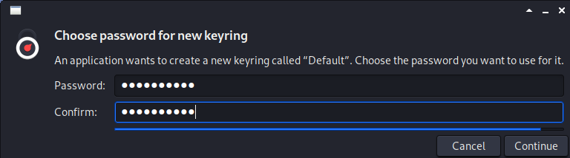
If you are ask for new password, please do so…

Slide 24
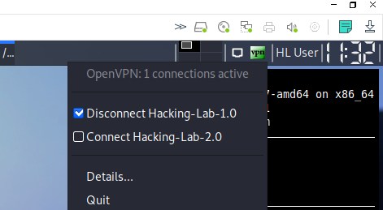
And you are connected ..

Slide 25
Take 4 - Network Sweeping for Live Hosts

Slide 26
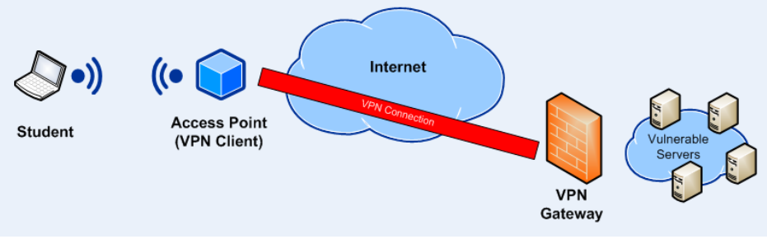
When your machine is connected to the VPN server, your machine get an IP assigned by the VPN server.

Slide 27
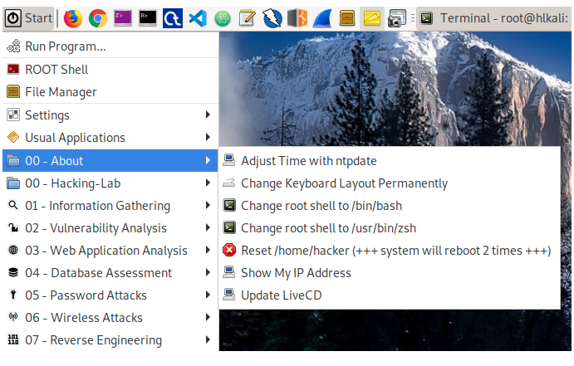
Follow the images below to find out what is the IP address of your machine assigned by the VPN Server.

Slide 28
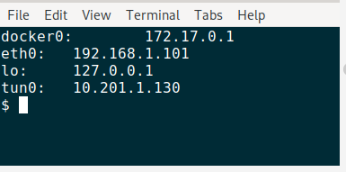
A terminal with your IP will appear, this IP is assigned by the DHCP server in the VPN Gateway.

Slide 29
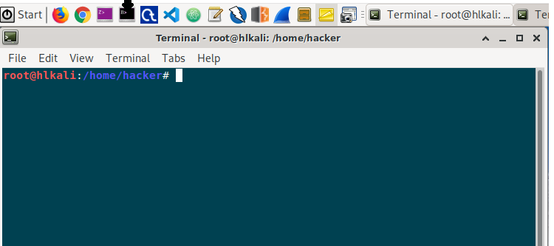
Seeing your Peers’ machines connected to the same VPN server
You can see all other machines connected to the VPN Server or Gateway. Open a bash shell with the root prompt.

Slide 30
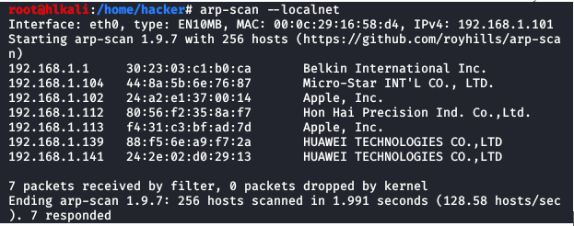
Follow the command line below to find out all the host devices connected to the VPN Gateway.

Slide 31
Activity 6.1 – Thinking
Are these external or internal host devices? Are they subjected to attacks?
Enter your answers into the spreadsheet in Week 6 Team Channel.

Slide 32
Hunt for machines behind the Router/Firewall
To hunt for machines behind the router/firewall, we need to figure out what are the likely network ID to scan or otherwise it will take a long time to scan for a live hosts.
We need other protocols to help us to sweep out the live machines behind the router/firewall because arp-scan only works on local subnet.

Slide 33
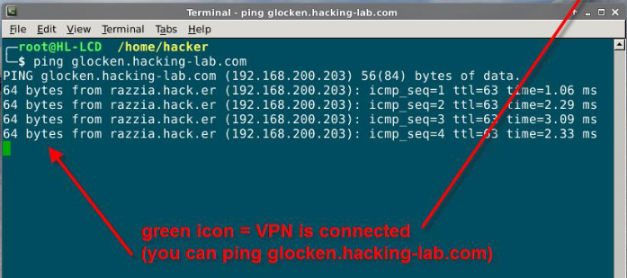
Base on help document found
https://www.hacking-lab.com/export/sites/www.hacking-lab.com/Remote_Sec_Lab/how-to-use-livecd.pdf
There is a host at 192.168.200.203

Slide 34
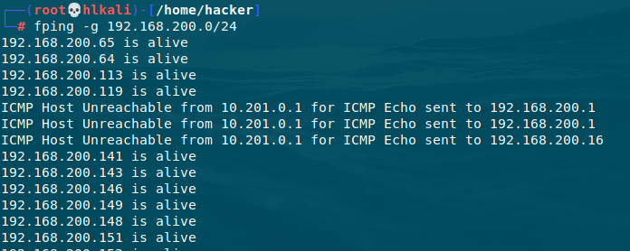
With this information, we can sweep for live hosts using the fping command as follows:

Slide 35
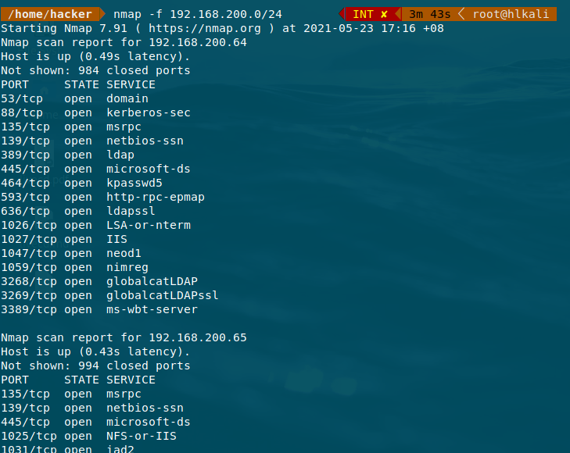
Let’s use nmap to find these machines…
What is –f option?
Source: https://pentestlab.blog/2012/04/02/nmap-techniques-for-avoiding-firewalls/

Slide 36
Activity 6.3 - Exploration
Choose one of the VM you found on the 192.168.200.0 subnet. Scan for the OS and Version of the software that are running.
No submission needed.

Slide 37
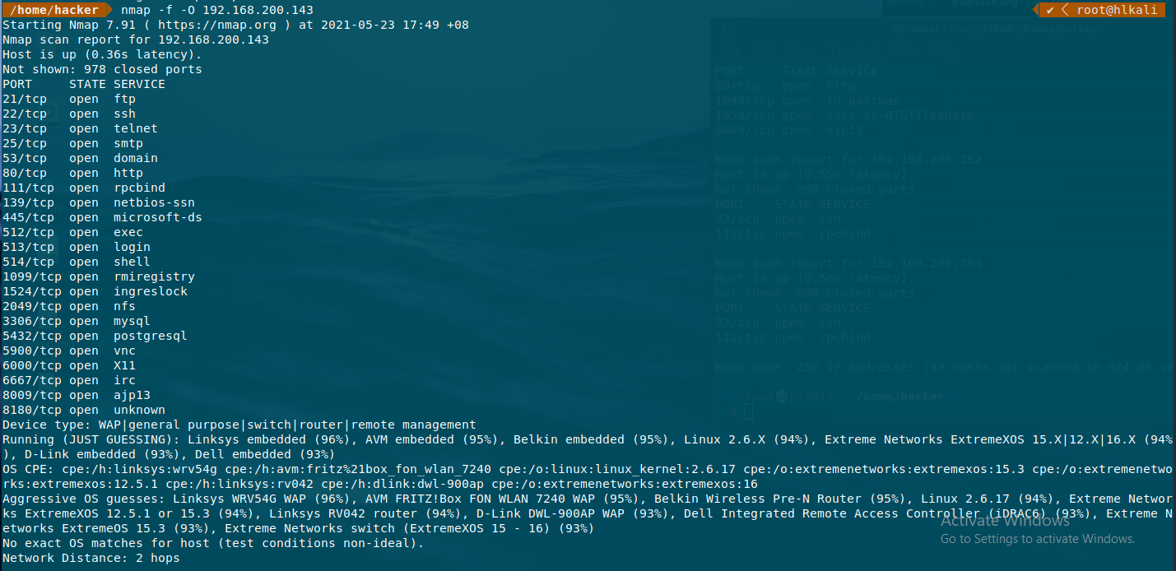

Slide 38
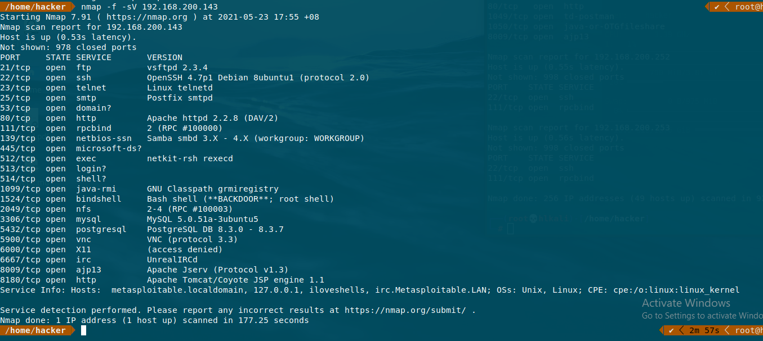

Slide 39
Task 5 - Scan Devices for Open Ports

Slide 40
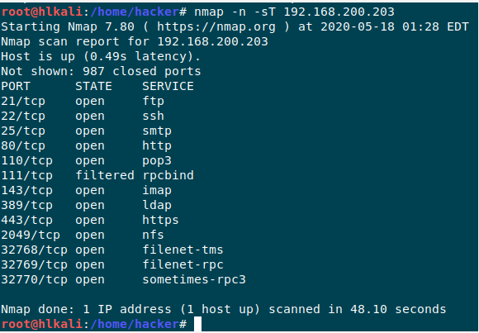
Scan for Open Ports on Selected Devices
nmap is the best tool to scan devices for open ports. An example of a nmap scan is as follows:
nmap has many different options and two of those on the above command line are as follows:
-n option - do not resolve domain name
-sT option - do a full TCP handshake scan.

Slide 41
Why scan for Open Ports?
The exercise in this topic is to discover the devices and map out the network Diagram or Architecture.
Knowing what ports are open in the device allow us to guess the purpose of the device and do simple testing to test each of the services.
We can also leaves the testing until we scan it for vulnerabilities to save time and efforts.

Slide 42
Challenges

Slide 43
Challenge 6.1
Zenmap is a GUI based devices scanning tool build on top of nmap.
Unfortunately, it does not come with Kali-Linux 2021.1.
Your task is to follow the below Youtube video to install Zenmap into the Hacker-Lab Live-CD VM that you have created on your own.
https://www.youtube.com/watch?v=o8EiGCS171c
You can also make us of the resource document “Installing Zenmap” in Class Materials - week 06 folder.
Use it to scan a VM in the 192.168.200.0 subnet. No submission needed.
Complete the exercise before week 7.

Slide 44
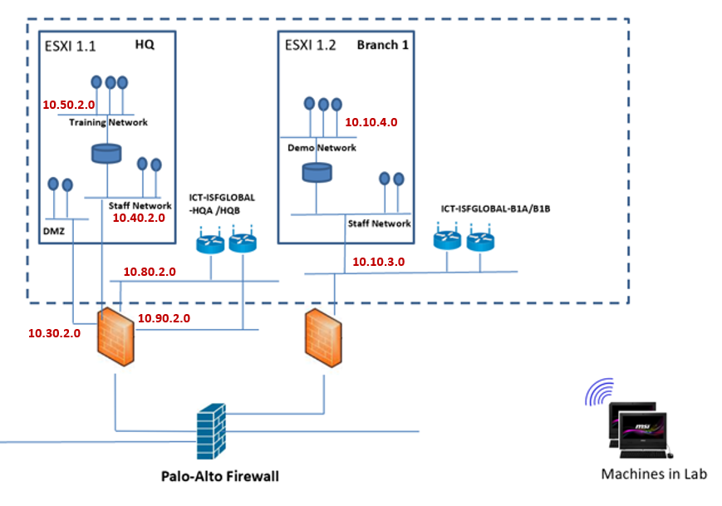
Challenge 6.2 (Optional)
If COVID gets better after the semester break and you can come back to school, map out the devices in ONE of the subnet.
Work in pair of two, no submission needed.

Slide 45
Summary
Tasks
Task 1 - Learning about Hacking-Lab Network Architecture
Task 2 - Getting an User Account at Hacking-Lab
Task 3 - Start Hacking-Lab Live CD VM and VPN into Hacking-Lab
Task 4 - Network Sweeping for Live Hosts
Task 5 - Scan Devices for Open Ports
Challenge

Slide 46
End

Slide 47
References
10 hping3 examples in Kali Linux a complete Beginner’s Guide
Https://www.cyberpratibha.com/blog/scan-network-using-packet-assembleranalyzer-hping3-in-kali-linux/
What is hping3? How to use?
https://www.systemconf.com/2020/11/15/what-is-hping3-how-to-use/
How to use ping, fping, and gping for various purpose in Linux
https://www.2daygeek.com/how-to-use-ping-fping-gping-in-linux/
17 Nmap Commands with Examples for Linux Network & System Administrators
https://phoenixnap.com/kb/nmap-command-linux-examples
How to use ping, fping, and gping for various purpose in Linux
https://www.2daygeek.com/how-to-use-ping-fping-gping-in-linux/

Slide 48
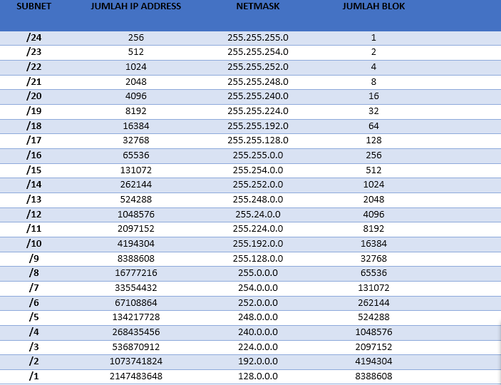
CIDR (Classless Inter-Domain Routing) Notation

Slide 49
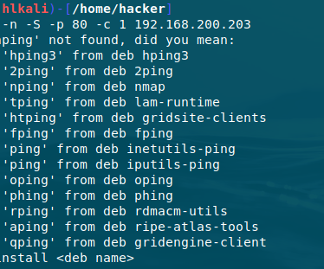
Variant of Ping

